Slide 1

Machine Learning
| Computer Science
Mitra Bokaei, Ph.D.
Assistant Professor of Computer Science
St. Mary’s University
https://github.com/pfv610/ML-camp

Slide 2
Review
Numpy Arrays
Pandas
DataFrames
Tuples

Slide 3
Numpy Arrays
Alternatives to Python Lists
Perform calculations across the entire array instead of applying the calculations on every single element
Let’s create two separate lists for height and weight
Create a third list containing the BMI for each element of height and weight

Slide 4
Tools
Anaconda
A popular platform for data science and machine learning
Jupyter Notebook
An interactive application that allows us to write, edit, and compile code through a web browser

Slide 5
BMI Calculation using Lists
height = [1.87, 1.87, 1.82, 1.91, 1.90, 1.85]
weight = [81.65, 97.52, 95.25, 92.98, 86.18, 88.45]
bmi = []
i = 0
while i < len(height):
bmi.append(weight[i] /height[i] ** 2)
print(bmi[i])
i = i+1

Slide 6
BMI Calculation using Numpy Array
height = [1.87, 1.87, 1.82, 1.91, 1.90, 1.85]
weight = [81.65, 97.52, 95.25, 92.98, 86.18, 88.45]
# Import the numpy package as np
import numpy as np
np_height = np.array(height)
np_weight = np.array(weight)
# Calculate bmi
bmi = np_weight / np_height ** 2
# Print the result
print(bmi)
Notes:
Exponentiation in some software. So a**b means a^b.
BMI = weight (kg) / [height (m)]^2
BMI = 703 * weight (lbs) / [height (in)]^2

Slide 7
Element-wise Calculations using Numpy
We calculated the BMI for six observations of height and weight only in one single statement.
Imagine that you have 1000 observations of height and weight!
This way your program faster and efficient!

Slide 8
Sub-setting
Which observations in our BMI array are related to underweight people?
If your BMI is less than 18.5, it falls within the underweight range.
If your BMI is 18.5 to 24.9, it falls within the normal or Healthy Weight range.
If your BMI is 25.0 to 29.9, it falls within the overweight range.
If your BMI is 30.0 or higher, it falls within the obese range.

Slide 9
Sub-setting Example Code
height = [1.87, 1.87, 1.82, 1.91, 1.90, 1.85]
weight = [81.65, 97.52, 95.25, 92.98, 86.18, 88.45]
import numpy as np
np_height = np.array(height)
np_weight = np.array(weight)
bmi = np_weight / np_height ** 2
print(bmi)
print (bmi[bmi < 25])
print (bmi[( bmi > 18.5) & (bmi <24.9)])
Notes:
https://thispointer.com/python-numpy-select-elements-or-indices-by-conditions-from-numpy-array/

Slide 10
Exercise
Ask ten of your classmates for their names, weight in pound, and height inches.
Create three lists for names, weight, and height
Create three Numpy arrays from name, weight, and height lists
Transform weights from pound to kilogram (divide the mass value by 2.205)
Transform height from inches to meters (divide the length value by 39.37)
Print the name Numpy array
Calculate and print the BMI

Slide 11
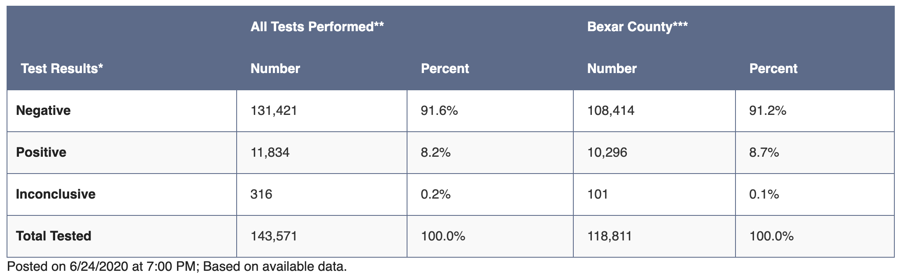
Panda DataFrames
Pandas is a high-level data manipulation tool
It is built on the Numpy package and its key data structure is called the DataFrame.
DataFrames allow you to store and manipulate tabular data in rows of observations and columns of variables.

Slide 12
Creating Pandas
There are several ways to create a DataFrame. One way way is to use a dictionary. For example:
dict = {"country": ["Brazil", "Russia", "India", "China", "South Africa"],
"capital": ["Brasilia", "Moscow", "New Dehli", "Beijing", "Pretoria"],
"population": [200.4, 143.5, 1252, 1357, 52.98] }
import pandas as pd
brics = pd.DataFrame(dict)
print(brics)

Slide 13
Creating Pandas – Cont.
Another way to create a DataFrame is by importing a csv file using Pandas.
https://www.learnpython.org/en/Pandas_Basics
# Import pandas as pd
import pandas as pd
# Import the cars.csv data: cars
cars = pd.read_csv('cars.csv')
# Print out cars
print(cars)

Slide 14
Script Output
 | Unnamed:0 | Cars_per_cap | Country | Drives_right
0 | US | 809 | United States | True
1 | AUS | 731 | Australia | False
2 | JAP | 588 | Japan | False
3 | IN | 18 | India | False
4 | RU | 200 | Russia | True
5 | MOR | 70 | Morocco | True
6 | EG | 45 | Egypt | True

Slide 15
Indexing DataFrames
To extract specific columns, we can use square brackets as series or DataFrames (https://www.learnpython.org/en/Pandas_Basics)
import pandas as pd
cars = pd.read_csv('cars.csv', index_col = 0)
# Print out country column as Pandas Series
print(cars['cars_per_cap'])
# Print out country column as Pandas DataFrame
print(cars[['cars_per_cap']])
# Print out DataFrame with country and drives_right columns
print(cars[['cars_per_cap', 'country']])

Slide 16
Retrieving Rows from DataFrames
Square brackets can also be used to access observations (rows) from a DataFrame. For example: (https://www.learnpython.org/en/Pandas_Basics)
# Import cars data
import pandas as pd
cars = pd.read_csv('cars.csv', index_col = 0)
# Print out first 4 observations
print(cars[0:4])
# Print out fifth and sixth observation
print(cars[4:6])

Slide 17
Function Zip() on Tuples
Tuple is an immutable (unchangeable) collection of elements of different data types.
It is an ordered collection, so it preserves the order of elements in which they were defined.
Tuples are defined by enclosing elements in parentheses () , separated by a comma.
The zip() function returns a zip object, which is an iterator of tuples where the first item in each passed iterator is paired together, and then the second item in each passed iterator are paired together etc.
If the passed iterators have different lengths, the iterator with the least items decides the length of the new iterator.

Slide 18
Function Zip() on Tuples - Example
a = ("John", "Charles", "Mike")
b = ("Jenny", "Christy", "Monica")
x = zip(a, b)
#use the tuple() function to display a readable version of the result:
print(tuple(x))

Slide 19
Machine Learning Introduction

Slide 20
What is programming?
Breaking down a task into a series of steps that can be followed
Learning to program is
Trial & error
Always experimental
Like learning a language
Building a vocabulary
Notes:
Scratch aims to explain the idea behind programming. It teaches that programming is about taking a complex task that you want a computer to do, and describing that as a series of specific steps.
The point of choosing from a set of simple blocks and snapping them together is to give kids an accessible visual metaphor for the concept of programming.

Slide 21
What is machine learning?
Machine learning involves building mathematical models to help understand data.
Creating and using models that are learned from data.

Slide 22
Modeling
What is a model?
A specification of a mathematical (or probabilistic)relationship that exists between different variables.
Example:
if you’re trying to raise money for your social networking site,
Build a business model (likely in a spreadsheet) that takes inputs like:
“number of users”
“ad revenue per user”
“number of employees”
outputs the annual profit for the next several years.
A cookbook recipe entails a model that relates inputs like “number of eaters” and “hungriness” to quantities of ingredients needed.

Slide 23
Modeling (Cont.)
The business model is probably based on simple mathematical relationships:
profit is revenue minus expenses, revenue is units sold times average price, and so on.
The recipe model is probably based on trial and error — someone went in a kitchen and tried different combinations of ingredients until they found one they liked.

Slide 24
Machine Learning’ Goal
To use existing data to develop models that we can use to predict various outcomes for new data
Predicting whether an email message is spam or not
Predicting whether a credit card transaction is fraudulent
Predicting which advertisement a shopper is most likely to click on
Predicting which football team is going to win the Super Bowl

Slide 25
Now can you give me some examples?
What are different devices that you deal with during the day that are using machine learning?
Google Maps (maps in general)
Uber, Lyft
Gmail and email categorization
Siri, Alexa, Google home assistant
Tesla cars (self driving cars in general)
Netflix recommendation system
Google Translate– trained on examples of documents that have been manually translated.
The auto-suggest on my phone keyboard, that suggests what word I might want to write next – trained on examples of what I’ve typed before.
Credit card fraud detection – trained on my buying patterns to recognize a purchase that might not actually be me.
Disease Diagnosis

Slide 26
Review - Traditional Programming
Rules
Traditional Programming
Answers
Data

Slide 27
Review – Machine Learning
Labels/Targets/Answers/classes
Machine Learning
Patterns/Rules
Data

Slide 28
Spam Detector
Notes:
First of all, what is spam?
What is a Nigerian spam?
How can we detect it?
You decide to make it using programming. You break down recognising spam emails into a series of steps that a computer can follow – what we’d describe as a rules-based approach.
So you add a rule to your program that says any email that mentions Nigeria is spam.
https://journeys.autopilotapp.com/blog/email-spam-trigger-words/

Slide 29
Nigerian Prince Scam Email
Also called "Nigerian letter" scams or "foreign money exchanges," these typically start with an email from someone overseas who claims to be royalty.
The fraudsters lure you in by offering a share of a huge investment opportunity or a fortune they can't get out of the country without your help.
While it's closely associated with the early internet, the Nigerian prince first went global in the 1980s when West African fraudsters began snail-mailing scam letters around the world.

Slide 30
Spam Detector – Cont.
Notes:
But that ends up binning your colleague’s email about a possible Geography project on Nigeria.
So you go back to your rules and change it so that only emails that mention Nigeria and money are spam.
Emails from your colleagues are safe!
But now that bins emails from your mobile phone network about how much calls cost while abroad. Which coming up to the summer would’ve been really useful!
The point is, trying to do this by manually identifying the right set of rules is difficult.
And slow.
And painful.
And as the set of rules get bigger and bigger and bigger over time, it becomes really difficult to manage. New rules you add will contradict or break rules that you added a month ago.

Slide 31
Machine Learning for spam Detector

Slide 32

Machine Learning for spam Detector- Cont.
Spam emails pile
Non-spam emails pile

Slide 33
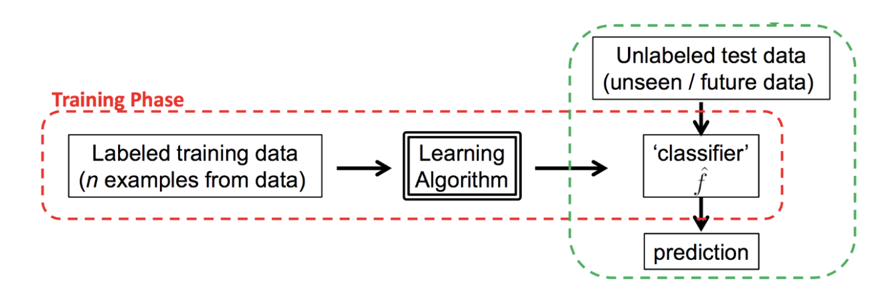
Machine Learning for spam Detector- Cont.
http://www.cs.columbia.edu/~verma/classes/ml/lec/lec1_intro_mle_bayes_naive_evaluation.pdf

Slide 34
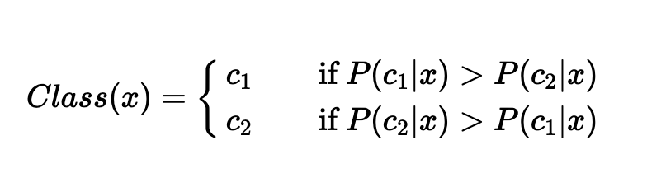
A Simple Approach to Binary Classification (spam or non-spam email)
We want to make a classification decision - spam(class 1) or non-spam(class 2)? - based on some evidence x, which we call email features, e.g., counts of important words or phrases (such as “prince”, “bill”, “money”, …)

Slide 35
Naïve Bayes
A Naive Bayes Classifier determines the probability that an example belongs to some class, calculating the probability that an event will occur given that some input event has occurred.
When it does this calculation it is assumed that all the predictors of a class have the same effect on the outcome, that the predictors are independent.

Slide 36
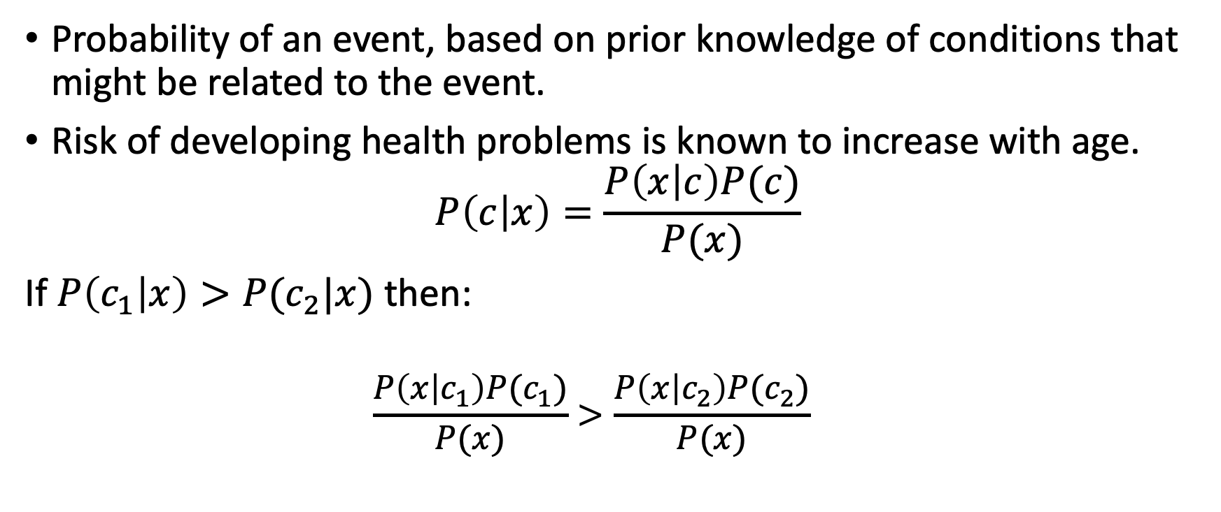
Bayes Theorem
Probability of an event, based on prior knowledge of conditions that might be related to the event.
Risk of developing health problems is known to increase with age.
$$P\left(c | x\right)=\frac{P\left(x | c\right)P(c)}{P(x)}$$
If $P\left(c_{1} | x\right)>P(c_{2}|x)$ then:
$$\frac{P\left(x | c_{1}\right)P(c_{1})}{P(x)}>\frac{P\left(x | c_{2}\right)P(c_{2})}{P(x)}$$

Slide 37
Categories of Machine Learning
Supervised learning
Unsupervised learning

Slide 38
Supervised learning
Modeling the relationship between measured features of data and some label associated with the data;
Once this model is determined, it can be used to apply labels to new, unknown data.
Further subdivided into
classification tasks: the labels are discrete categories
Regression tasks: the labels are continuous quantities

Slide 39
Unsupervised learning
Modeling the features of a dataset without reference to any label
Clustering algorithms
Identify distinct groups of data

Slide 40
Classification as a Type of Supervised Learning
How would you differentiate a spam email from not spam?

Slide 41
Training a Classification Model
Supervised learning means that the data fed to the model is already labeled, with the important features/attributes already separated into distinct categories beforehand.
This means that the model learns which parts of the features are important, and there is also a target that the model can check itself against.
The process of training a model is the process of feeding data into a model and letting it learn the patterns of the data.
The training process takes in the data and pulls out the features of the dataset.
During the training process for a classification task the model is passed both the features and the labels of the training data.
However, during testing, the network is only fed features.

Slide 42
Testing a Classification Model
The testing process is where the patterns that the model has learned are tested.
The features are given to the network, and the network must predict the labels.
The data for the model is divided into training and testing sets, two different sets of inputs.
You do not test the classifier model on the same dataset you train it on, as the model has already learned the patterns of this set of data and it would be extreme bias.
Instead, the dataset is split up into training and testing sets, a set the classifier trains on and a set the classifier has never seen before.

Slide 43
Classification Pipeline
Preparing data
Creating training/testing sets
Instantiating the classification Model
Training the classifier
Making predictions
Evaluating performance

Slide 44
Step 1: Preparing Data
The first step to training a classifier on a dataset is to prepare the dataset - to get the data into the correct form for the classifier and handle any anomalies in the data.
If there are missing values in the data, outliers in the data, or any other anomalies these data points should be handled, as they can negatively impact the performance of the classifier.
This step is referred to as data preprocessing.

Slide 45
Step 2: Creating Training/Testing Sets
Once the data has been preprocessed, the data must be split into training and testing sets.

Slide 46
Step 3: Instantiating the Classification Model
As previously discussed, the classification model has to be instantiated and trained on the training data.

Slide 47
Step 4: Making Predictions
After this, predictions can be made with the classification model.

Slide 48
Step 5: Evaluating Performance
By comparing the predictions made by the classification model to the actual known values of the labels in the test data, we can get a measurement of how accurate the classification model is.
There are various methods comparing the predicted labels to the actual labels and evaluating the classification model.
Classification accuracy: the number of correct predictions divided by all predictions or a ratio of correct predictions to total predictions.

Slide 49
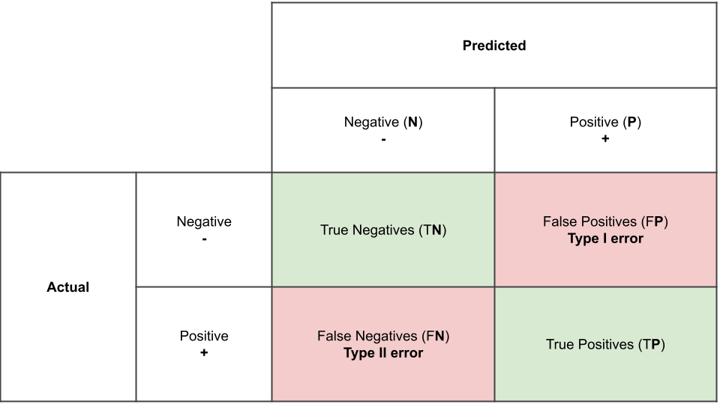
Step 5: Evaluating Performance (Cont.)
Confusion matrix
Confusion matrix

Slide 50
Step 5: Evaluating Performance (Cont.)
Precision for a class is the number of true positives (i.e. the number of items correctly labelled as belonging to the positive class) divided by the total number of elements labelled as belonging to the positive class (i.e. the sum of true positives and false positives, which are items incorrectly labelled as belonging to the class).
Recall is defined as the number of true positives divided by the total number of elements that actually belong to the positive class (i.e. the sum of true positives and false negatives, which are items which were not labelled as belonging to the positive class but should have been).

Slide 51
Introducing Scikit-Learn
Python library that provide solid implementations of a range of machine learning algorithms
Open your command line (cmd on Windows and terminal on Mac) and type the following command
conda install -c conda-forge scikit-learn

Slide 52
Data Representation in Scikit-Learn
Machine learning is about creating models from data.
For that reason, we’ll start by discussing how data can be represented in order to be understood by the computer.
The best way to think about data within Scikit-Learn is in terms of tables of data.

Slide 53
Iris Data as a Table
Famously analyzed by Ronald Fisher in 1936.
We can download this dataset in the form of a Pandas DataFrame using the Seaborn library
More about Iris data

Slide 54
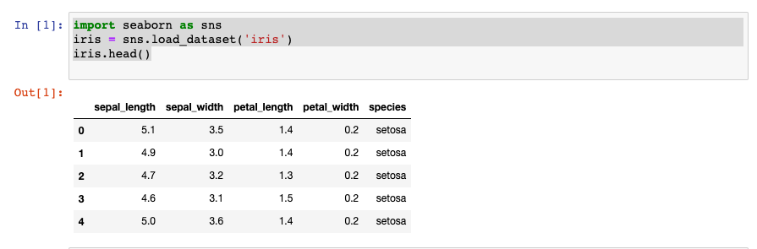
Iris Data as a Table - Code

Slide 55
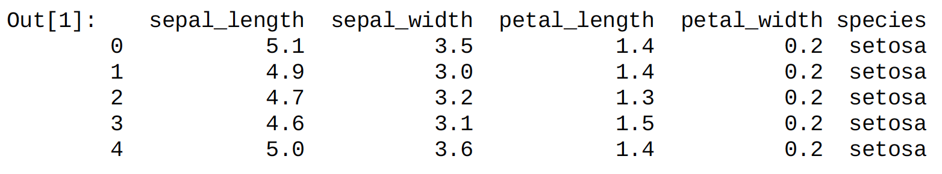
Iris Data
Each row of the data refers to a single observed flower, and the number of rows is the total number of flowers in the dataset. In general, we will refer to the rows of the matrix as samples , and the number of rows as n_samples .
Each column of the data refers to a particular quantitative piece of information that describes each sample. In general, we will refer to the columns of the matrix as features , and the number of columns as n_features .

Slide 56
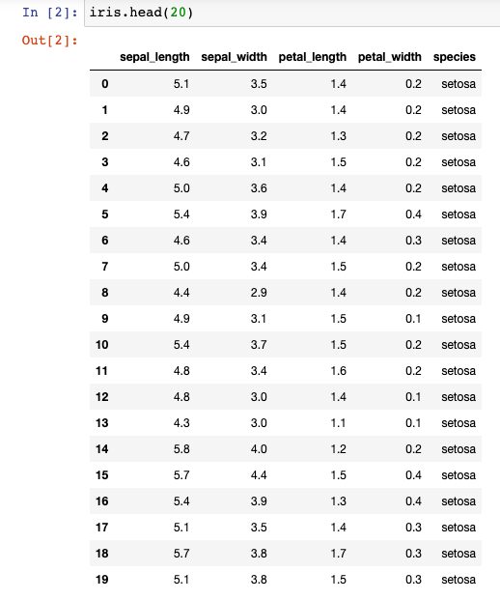

Slide 57
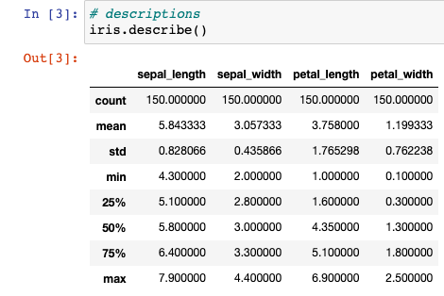
Basic Statistics of Iris Data
Notes:
https://stackabuse.com/overview-of-classifycation-methods-in-python-with-scikit-learn

Slide 58



Iris species
Iris versicolor
Iris virginica
Iris Setosa

Slide 59
Features matrix
This table layout makes clear that the information can be thought of as a two-dimensional numerical array or matrix, which we will call the features matrix .
By convention, this features matrix is often stored in a variable named x
The features matrix is assumed to be two-dimensional, with shape [n_samples, n_features] , and is most often contained in a NumPy array or a Pandas DataFrame.

Slide 60
Target Array
In addition to the feature matrix x, we also generally work with a label or target array, which by convention we will usually call y.
The target array is usually one dimensional, with length n_samples, and is generally contained in a NumPy array or Pandas Series.
The distinguishing feature of the target array is that it is usually the quantity we want to predict from the data: in statistical terms, it is the dependent variable.
For example, in the preceding data we may wish to construct a model that can predict the species of flower based on the other measurements; in this case, the species column would be considered the feature.

Slide 61
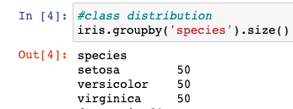
Iris Data - Target Array

Slide 62
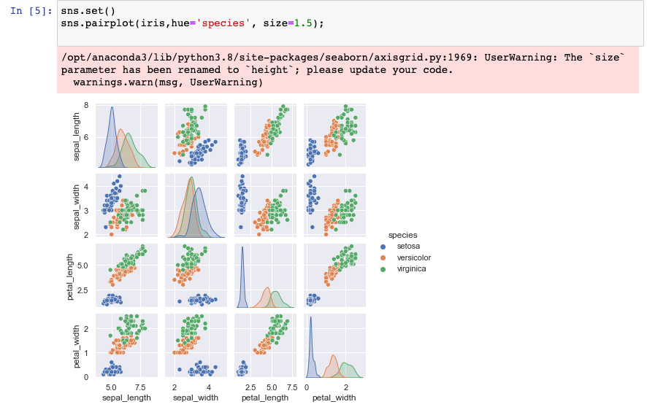
Iris Data – Visualization using Seaborn
Seaborn is an API that provides visualization on Pandas DataFrames.
With target array in mind, we can use Seaborn to visualize Iris data.
Notes:
https://machinelearningmastery.com/machine-learning-in-python-step-by-step/
Page 895 for visualization

Slide 63
Iris Data – Classification Pipeline Code
from sklearn.model_selection import train_test_split
from sklearn.metrics import classification_report
from sklearn.metrics import confusion_matrix
from sklearn.metrics import accuracy_score
X_iris= iris.drop('species', axis=1)
X_iris.shape
y_iris=iris['species']
y_iris.shape
Xtrain, Xtest, ytrain, ytest = train_test_split(X_iris,y_iris, random_state=1)
Notes:
# Test size specifies how much of the data you want to set aside for the testing set. # Random_state parameter is just a random seed we can use. # You can use it if you'd like to reproduce these specific results.

Slide 64
Iris Data – Classification Pipeline Code (Cont.)
#Choose a model and fit it on training data (learning)
model= GaussianNB()
model.fit(Xtrain, ytrain)
#predict on the test data
yPredicition = model.predict(Xtest)
#Evaluate the preformance
print(accuracy_score(ytest, yPredicition))
print(confusion_matrix(ytest, yPredicition))
print(classification_report(ytest, yPredicition))

Slide 65
from sklearn.naive_bayes import GaussianNB
In this classifier, the assumption is that data from each label is drawn from a simple Gaussian distribution
Notes:
In Depth: Naive Bayes Classification
Page 1061
Perhaps the easiest naive Bayes classifier to understand is Gaussian naive Bayes. In this classifier, the
assumption is that data from each label is drawn from a simple Gaussian distribution

Slide 66
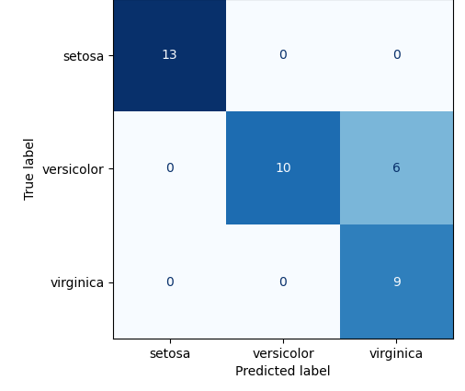
Iris Data– Classification Confusion Matrix
13
15
1
9

Slide 67
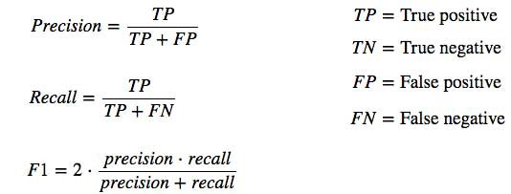
Calculating Precision and Recall for Iris Data

Slide 68
Some Definitions
Support is the number of actual occurrences of the class in the specified dataset.
Macro avg
Weighted avg

Slide 69
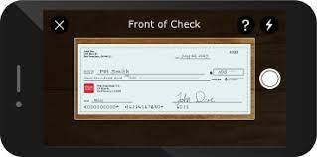
Handwritten Digits
Optical character recognition problem: the identification of handwritten digits
In the wild, this problem involves both locating and identifying characters in an image.
Here we’ll take a shortcut and use Scikit-Learn’s set of preformatted digits, which is built into the library.

Slide 70
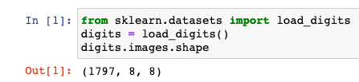
Loading the Digits Data
The images data is a three-dimensional array: 1,797 samples, each consisting of an 8×8 grid of pixels.

Slide 71
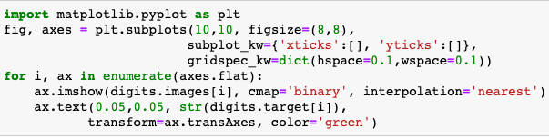
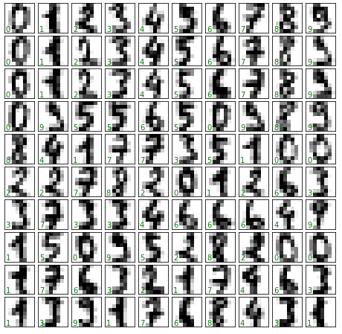
Visualizing the Digits Data

Slide 72
Feature Matrix and Target Array
In order to work with this data within Scikit-Learn, we need a two-dimensional, [n_samples, n_features] representation.
We can accomplish this by treating each pixel in the image as a feature — that is, by flattening out the pixel arrays so that we have a length-64 array of pixel values representing each digit.
Additionally, we need the target array, which gives the previously determined label for each digit.
These two quantities are built into the digits dataset under the data and target attributes.

Slide 73
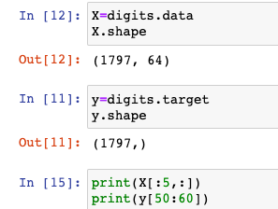
Feature Matrix and Target Array (Cont.)

Slide 74
Train and Test Set Splits
As with the Iris data previously, we will split the data into a training and test set.
Notes:
On a serious note, random_state simply sets a seed to the random generator, so that your train-test splits are always deterministic. If you don't set a seed, it is different each time.
The default split size in sklearn.model_selection.train_test_split are 75% training and 25% testing data split.
A random seed specifies the start point when a computer generates a random number sequence.
Computers don’t generate truly random numbers—they are deterministic, which means that they operate by a set of rules. You can mimic randomness by specifying a set of rules. For example, “take a number x, add 900 +x, then subtract 52.” In order for the process to start, you have to specify a starting number, x (the seed). Let’s take the starting number 77:
Add 900 + 77 = 977
Subtract 52 = 925

Slide 75
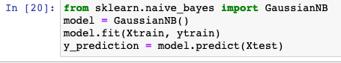
Instantiating and Fitting the Model

Slide 76
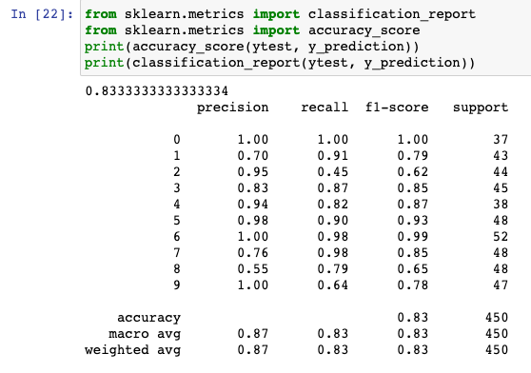
Performance Evaluation

Slide 77
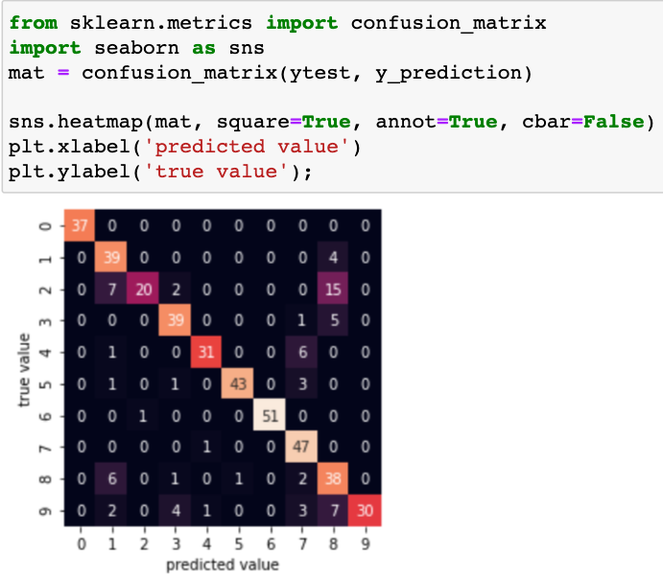
Confusion Matrix
This shows us where the mislabeled points tend to be: for example, a large number of twos here are misclassified as either ones or eights.

Slide 78
Classification Algorithms and Comparison
Naive Bayes
Logistic regression
K-nearest neighbors
(Kernel) SVM
Decision tree

Slide 79
Naive Bayes
Naive Bayes applies the Bayes’ theorem to calculate the probability of a data point belonging to a particular class/label.
Given the probability of certain related values, the formula to calculate the probability of an event B, given event A to occur is calculated: P(B|A) = (P(A|B) * P(B) / P(A))
This theory is considered naive, because it assumes that there is no dependency between any of the input features.
Naive Bayes algorithm has been proven to perform really well in certain use cases like spam filters.

Slide 80
Logistic Regression
Logistic regression is an extension to the linear regression algorithm.
Linear regression algorithm: the variable to be predicted depends on only one other variable.
This is calculated by using the formula that is generally used in calculating the slope of a line.
y = w₀ + w₁ * x₁
y refers to the target variable,
x₁ refers to the independent variable
w₁ refers to the coefficient that expresses the relationship between y and x₁ and is also known as the slope.
w₀ is the constant coefficient, or the intercept. It refers to the constant offset that y will always be with respect to the independent variables.
Notes:
https://medium.com/codex/house-price-prediction-with-machine-learning-in-python-cf9df744f7ff

Slide 81
Logistic Regression (Cont.)
In a logistic regression algorithm, instead of predicting the actual continuous value, we predict the probability of an outcome.
To achieve this, a logistic function is applied to the outcome of the linear regression.
This outputs a value between 0 and 1.

Slide 82
K-nearest neighbors
The general idea behind K-nearest neighbors (KNN) is that data points are considered to belong to the class with which it shares the most number of common points in terms of its distance.
K number of nearest points around the data point to be predicted are taken into consideration.
These K points at this time already belong to a class.
The data point under consideration is said to belong to the class with which the most number of points from these K points belong.
The most popular formula to calculate this is the Euclidean distance.

Slide 83
Support Vector Machines
Support Vector Machines (SVM) output an optimal line of separation between the classes, based on the training data entered as input.
This line of separation is called a hyperplane in a multi-dimensional environment.
After the model is constructed with this hyperplane, any new point to be predicted checks to see which side of the hyperplane this values lies in.

Slide 84
Decision Trees
Decision tree-based models use training data to derive rules that are used to predict an output.
For example, assume that the problem statement was to identify if a person can play tennis today.
Depending on the values from the training data, the model forms a decision tree.
First check the outlook column. If it’s overcast, you definitely never go.
But if it’s sunny and humid, then you don’t go.
If it’s sunny and normal, you go.
If it’s rainy and windy, you don’t go.
And if it’s rainy and not windy, you go.

Slide 85
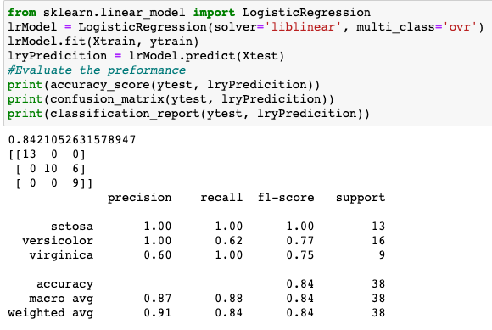
Iris Data – Logistic Regression Model
Notes:
LIBLINEAR is the winner of ICML 2008 large-scale learning challenge. It applies Automatic parameter selection (a.k.a L1 Regularization) and it’s recommended when you have high dimension dataset (recommended for solving large-scale classification problems)
Overfitting is a phenomenon that occurs when a machine learning or statistics model is tailored to a particular dataset and is unable to generalise to other datasets. This usually happens in complex models, like deep neural networks.
Regularisation is a process of introducing additional information in order to prevent overfitting.
Multi_class = ‘ovr’
One Vs. rest or one vs. all

Slide 86
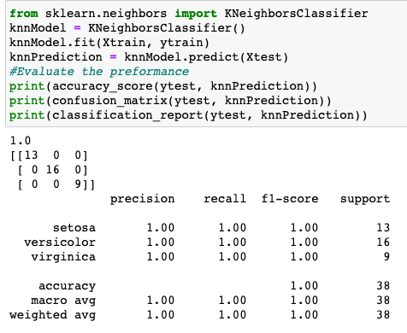
Iris Data – K-nearest neighbors

Slide 87
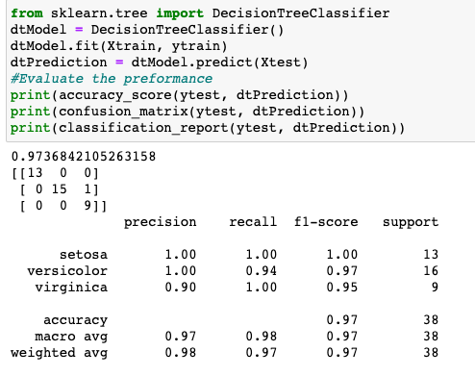
Iris Data – Decision Tree

Slide 88
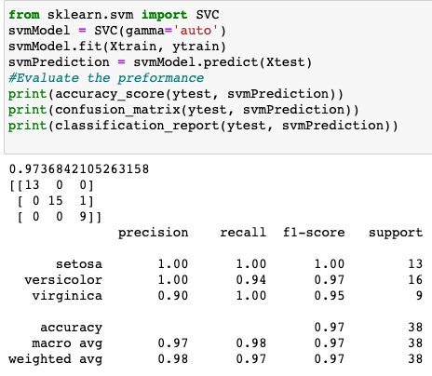
Iris Data – Support Vector Machine (SVM)
Notes:
The gamma parameter defines how far the influence of a single training example reaches, with low values meaning ‘far’ and high values meaning ‘close’.

Slide 89
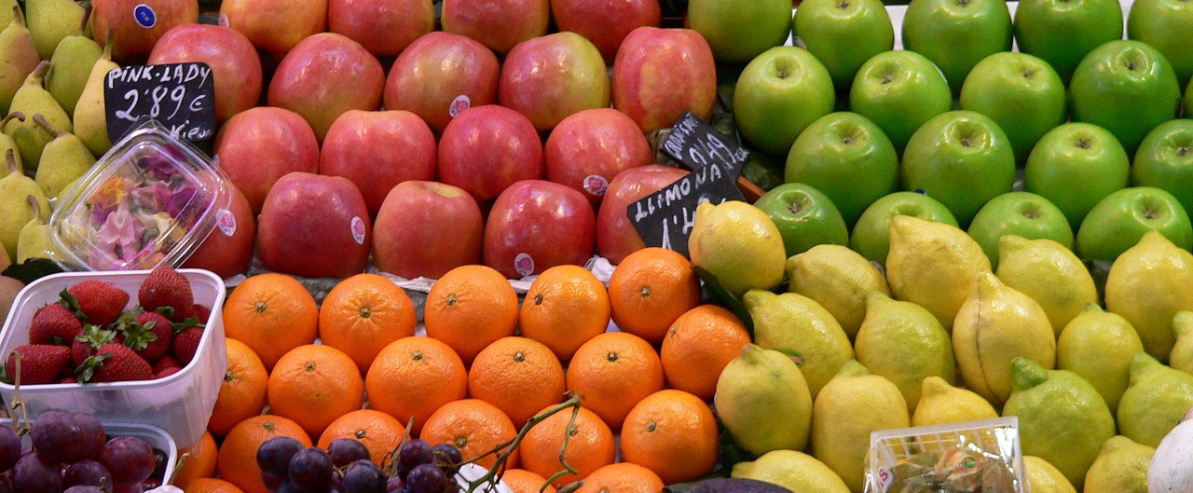
Classification Model: Distinguish between Different Types of Fruits
Notes:
https://towardsdatascience.com/solving-a-simple-classification-problem-with-python-fruits-lovers-edition-d20ab6b071d2

Slide 90
Fruits Data
The fruits dataset was created by Dr. Iain Murray from University of Edinburgh. He bought a few dozen oranges, lemons and apples of different varieties, and recorded their measurements in a table. And then the professors at University of Michigan formatted the fruits data slightly and it can be downloaded from here.
Notes:
https://towardsdatascience.com/solving-a-simple-classification-problem-with-python-fruits-lovers-edition-d20ab6b071d2

Slide 91
Fruits Classification Model
import pandas as pd
import matplotlib.pyplot as plt
fruits = pd.read_table('fruit_data_with_colors.txt')
fruits.head()
fruits.pop('fruit_label')
fruits.head()
fruits.pop('fruit_subtype')
fruits.head()
print(fruits.shape)
print(fruits['fruit_name'].unique())
print(fruits.groupby('fruit_name').size())

Slide 92
import seaborn as sns
sns.countplot(fruits['fruit_name'],label="Count")
plt.show()
from matplotlib import pyplot
# histograms
#Create histogram of each input variable to get an idea of the distribution.
fruits.hist()
pyplot.show()
#It looks like perhaps color score has a near Gaussian distribution.
sns.set()
sns.pairplot(fruits,hue='fruit_name', size=1.5);
# descriptions
fruits.describe()
#We can see that the numerical values do not have the same scale.
#We will need to apply scaling to the test set that we computed for the training set.

Slide 93
X= fruits.drop('fruit_name', axis=1)
X.Shape
y=fruits['fruit_name']
y.Shape
#Create Training and Test Sets and Apply Scaling
from sklearn.model_selection import train_test_split
X_train, X_test, y_train, y_test = train_test_split(X, y, random_state=0)
from sklearn.preprocessing import MinMaxScaler
scaler = MinMaxScaler()
X_train = scaler.fit_transform(X_train)
X_test = scaler.transform(X_test)
from sklearn.metrics import classification_report
from sklearn.metrics import confusion_matrix
from sklearn.metrics import accuracy_score
from sklearn.naive_bayes import GaussianNB

Slide 94
#Choose a model and fit it on training data (learning)
model= GaussianNB()
model.fit(X_train, y_train)
#predict on the test data
y_predicition = model.predict(X_test)
#Evaluate the preformance
print(accuracy_score(y_test, y_predicition))
print(confusion_matrix(y_test, y_predicition))
print(classification_report(y_test, y_predicition))

Slide 95
Unsupervised Learning: Clustering Algorithms
Clustering algorithms seek to learn, from the properties of the data, an optimal division or discrete labeling of groups of points.
Many clustering algorithms are available in Scikit-Learn and elsewhere, but perhaps the simplest to understand is an algorithm known as k-means clustering , which is implemented in sklearn.cluster.Kmeans
Example: Topic Modeling

Slide 96
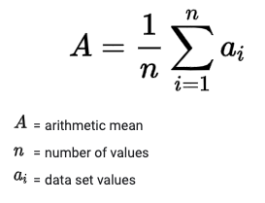
Introducing k-Means
The k -means algorithm searches for a predetermined number of clusters within an unlabeled multidimensional dataset.
It accomplishes this using a simple conception of what the optimal clustering looks like:
The “cluster center” is the arithmetic mean of all the points belonging to the cluster.
Each point is closer to its own cluster center than to other cluster centers.

Slide 97
In Depth: k-Means Clustering
k-Means Algorithm: Expectation–Maximization algorithm
In short, the expectation–maximization approach consists of the following procedure:
1. Guess some cluster centers
2. Repeat until converged
a. E-Step : assign points to the nearest cluster center b. M-Step : set the cluster centers to the mean

Slide 98
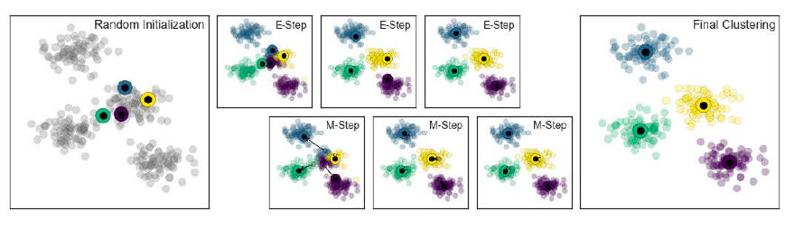
Visualization of the E–M algorithm for k-means

Slide 99
k-Means on digits
Here we will attempt to use k -means to try to identify similar digits without using the original label information
This might be similar to a first step in extracting meaning from a new dataset about which you don’t have any a priori label information
We will start by loading the digits and then finding the KMeans clusters. Recall that the digits consist of 1,797 samples with 64 features, where each of the 64 features is the brightness of one pixel in an 8×8 image.

Slide 100
